Slide 1
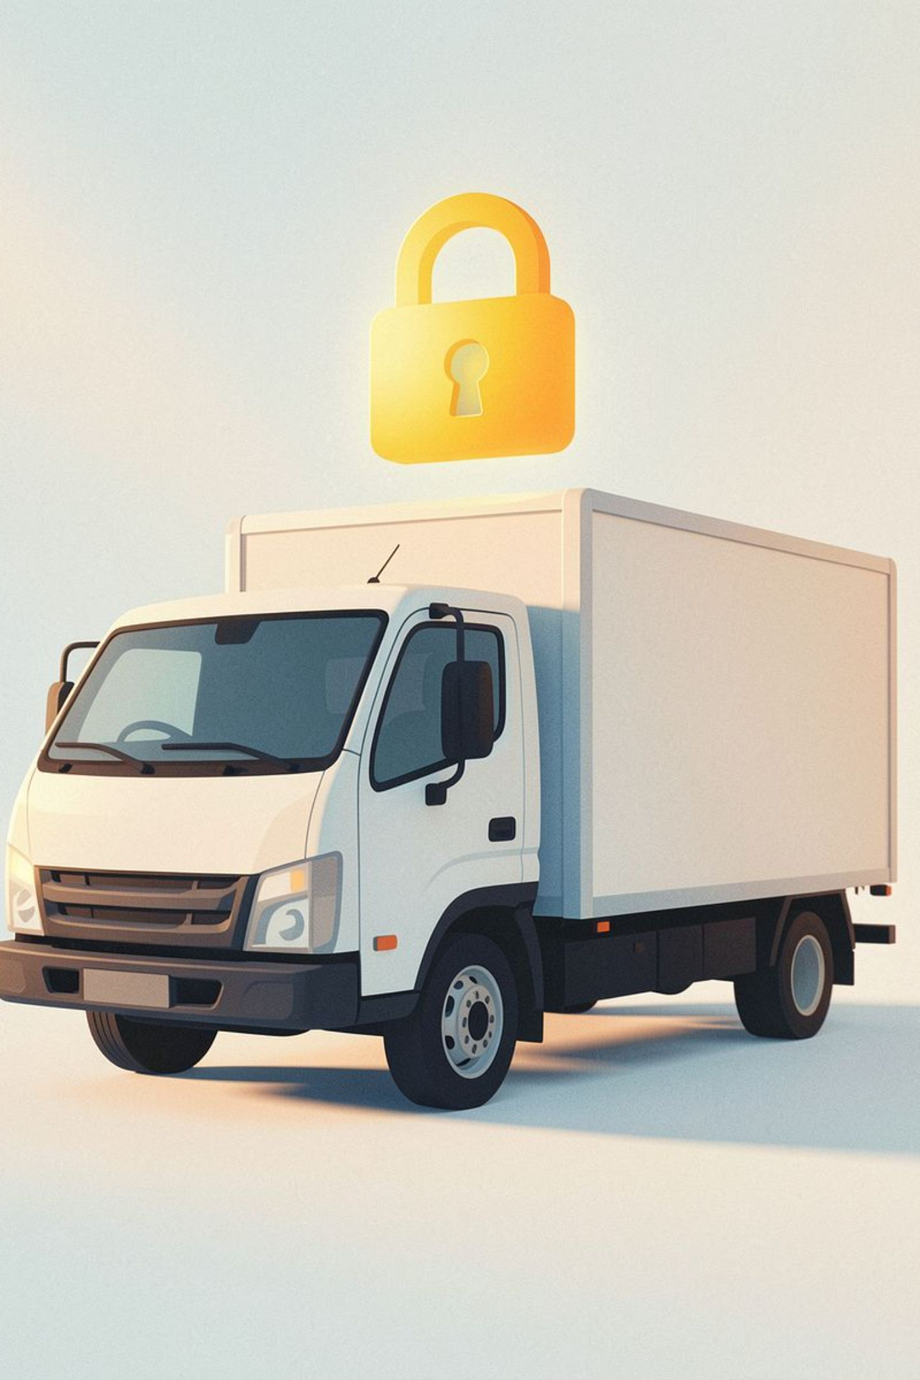
LOCUS: The Exact Point of Truth in Logistics
The Problem
The Solution
Intra-city logistics is a chaotic "black box" of delays, damaged goods, and delivery disputes.
LOCUS is a zero-trust logistics OS. We use AI vision, smart hub networks, and tamper-proof tech to guarantee transparent, fast, and verified deliveries.

Slide 2

The Black Box of Ground Logistics
🕳️ Transit Black Hole
Parcels get misrouted or stuck in city traffic.
🚪 Couch Delivery Fraud
Drivers fake delivery attempts without visiting the address.
💥 Damage Disputes
Merchants absorb losses due to lack of proof.
📞 Support Friction
Endless "Where is my order?" calls from angry buyers.

Slide 3
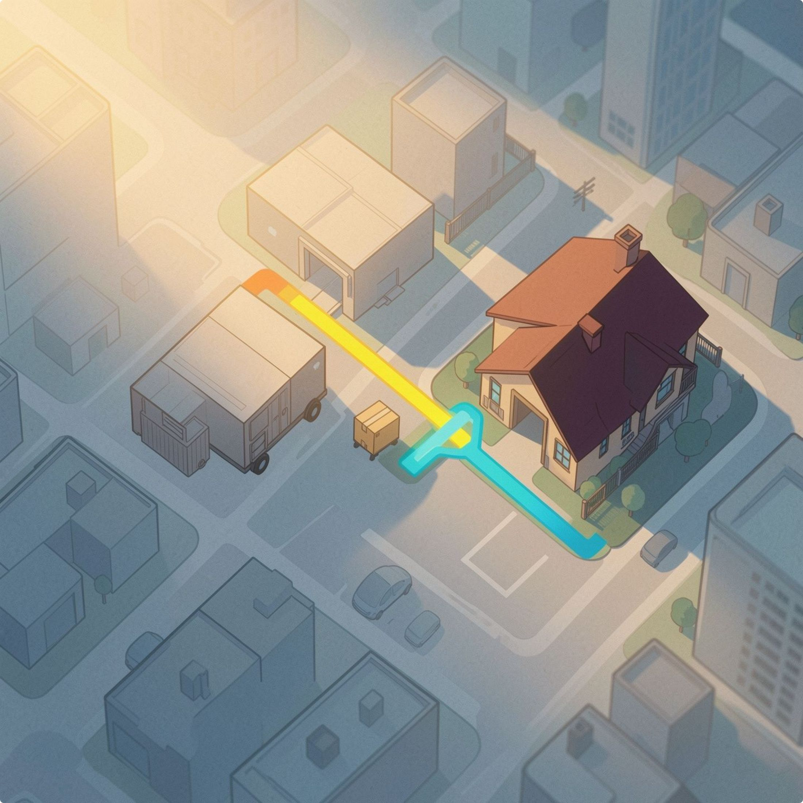
Intake to Doorstep in 4 Steps
1
AI Vision Intake
Scan paper invoices in 3 seconds to auto-extract details.
2
Expressway Network
Heavy shipments bypass city traffic via Outer Ring Roads.
3
Smart Routing
AI clusters last-mile stops for maximum efficiency.
4
Doorstep Verification
Delivery unlocks only at the exact GPS location with a customer OTP.

Slide 4

Zero-Trust Physics and Cryptography
Anti-Clone Engine
Detects duplicate scans and impossible driver speeds.
Stowaway Self-Healing
Auto-corrects mistakenly routed packages instantly.
Geofence Lock
OTP only works within 100 meters of the customer's doorstep.
Dead-Battery Handover
If a driver's phone dies, another device can instantly resume the exact route.

Slide 5
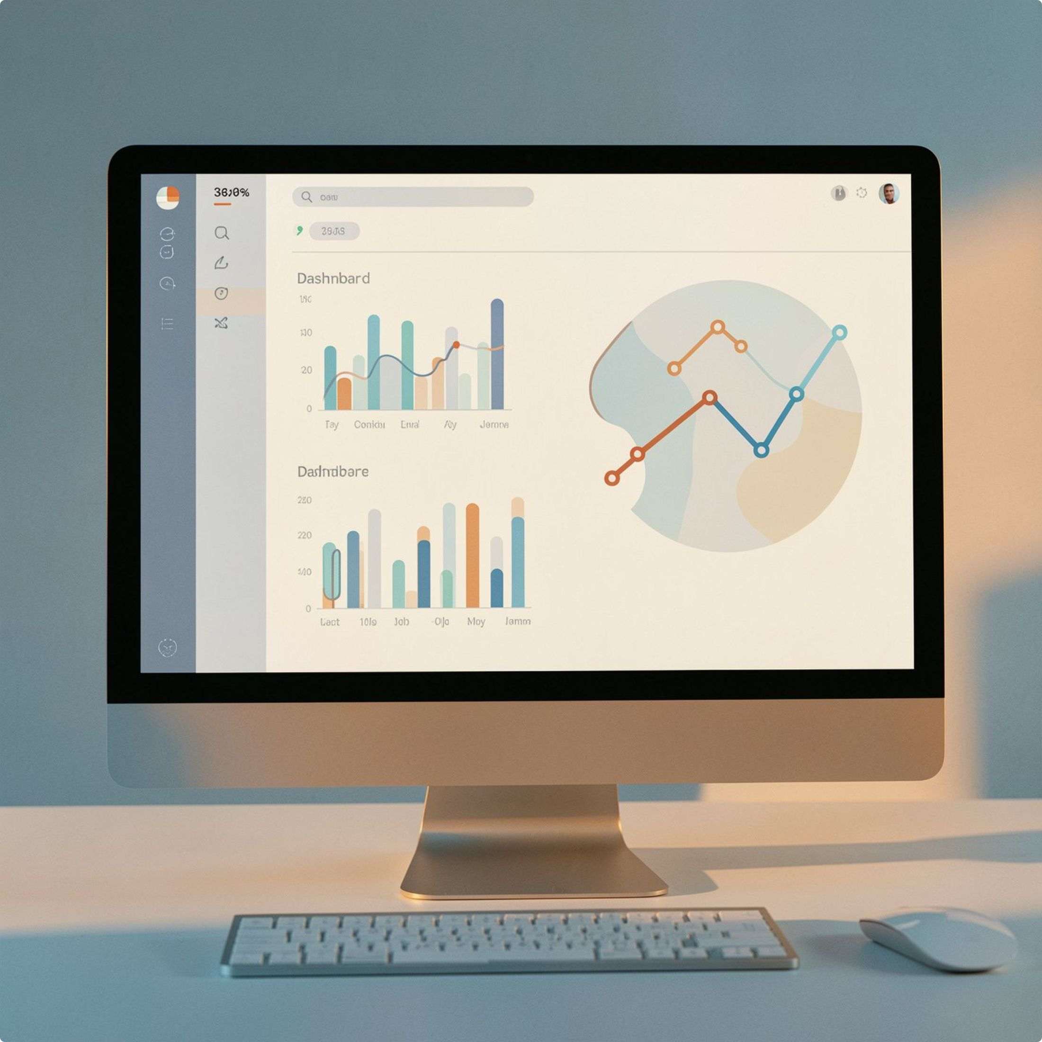
Total Visibility for Hub Managers & Customers
For the Hub Manager
Live command center with real-time tracking
AI alerts for highway delays
For the Customer
Live tracking link
Pickup condition photos
A VERIFIED GENUINE security badge

Slide 6

Built for B2B, Not Just Taxi Rides
⚡ Batch Intake
Hand over 15+ boxes in 3 minutes via AI camera — instead of booking 15 separate taxi rides.
🔒 Tamper-Proof
Condition photos + sealed bags eliminate dispute losses.
📅 No Surge Pricing
Scheduled, predictable line-haul departures.
✅ Professionalism
Automated tracking links replace confused driver phone calls.

Slide 7
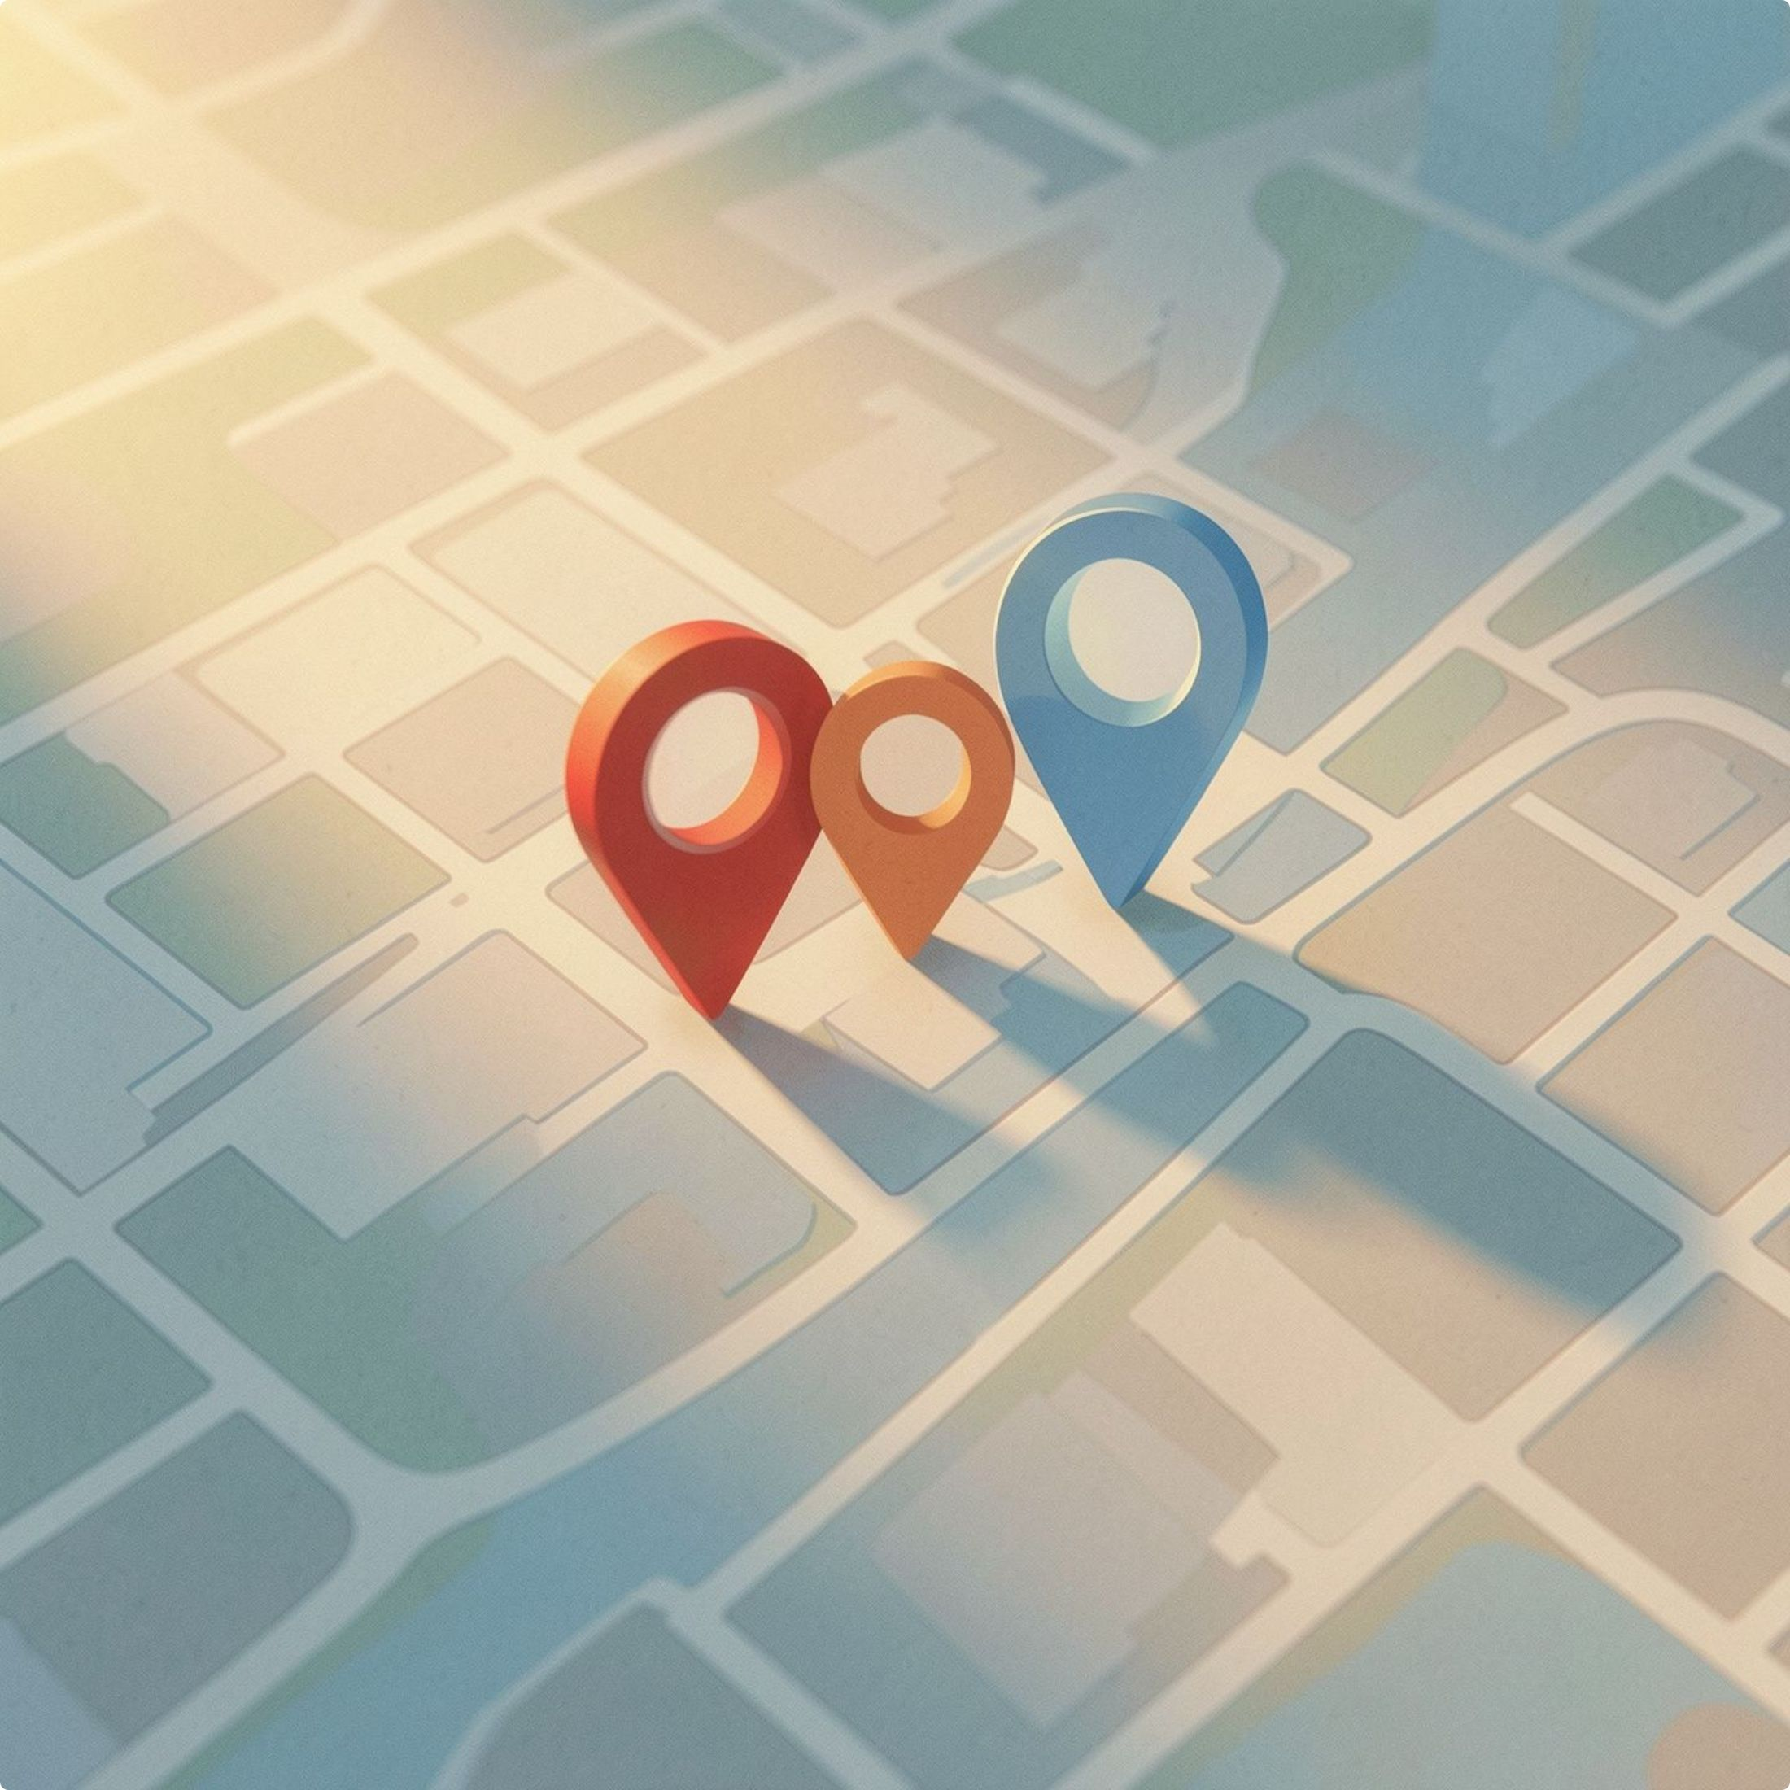
High Density, Low Fatigue, Total Protection
High Delivery Density
35–40 drops in a tight 8–10km radius. No driving 30km and returning empty.
Pre-Optimized Routes
Clean loops with one-tap Google Maps coordinates.
1
Zero Fraud Risk
Geofenced OTPs protect drivers from false "never received" customer claims.
2
3

Slide 8

Point-to-Point Apps vs. LOCUS Network
Category
Point-to-Point Apps
LOCUS Network
Booking
15 separate rides
1 Batch AI Intake
Security
Zero condition tracking
Cryptographic Proof
Travel
Erratic cross-city trips
Compact Local Clusters
Protection
Vulnerable drivers
Geofenced OTP Deliveries

Slide 9
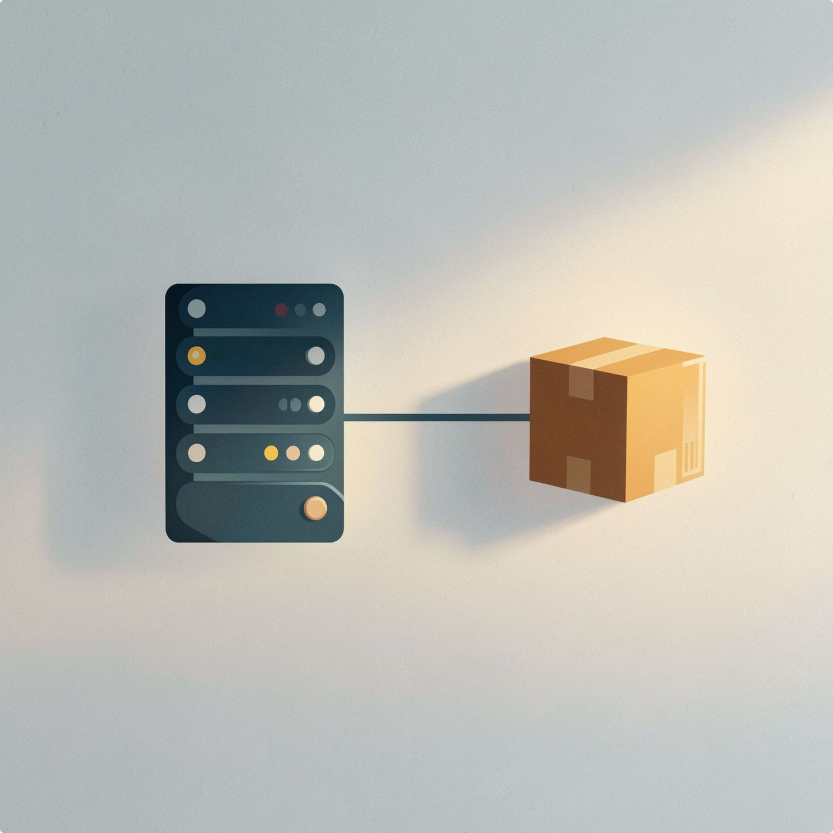
Military-Grade Tech. Same-Day Speed.
Frontend
Next.js 14, React Native (Mobile), GSAP 3D.
Backend
FastAPI (Python), PostgreSQL, Supabase Realtime.
AI & Routing
Mistral AI Vision, OSRM Road Routing.
Status
100% functional and verified end-to-end.

